Slide 1

Using Oracle Virtualbox
By: Abdiraham Aynab, Ben Widrig, Ernest Graham, Kayla Bunke, Pellegrino Adu Gymafi

Slide 2
What Is pfSense and How to Install It
Kayla Bunke

Slide 3
What is pfSense
An open source software used for network security and routing
Is an enterprise-grade tool with many capabilities
Can be used on hardware appliances or a virtual machine
Is most commonly used as a firewall or router

Slide 4
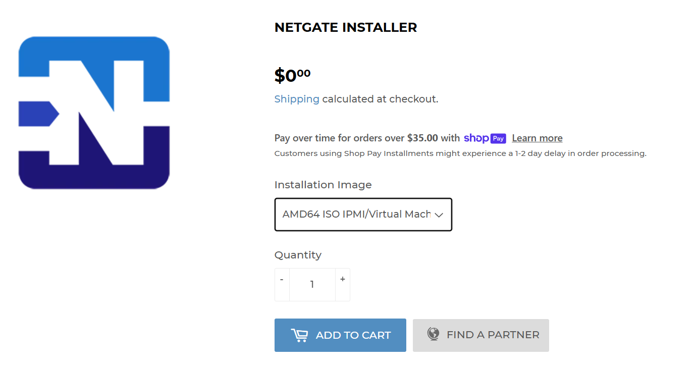
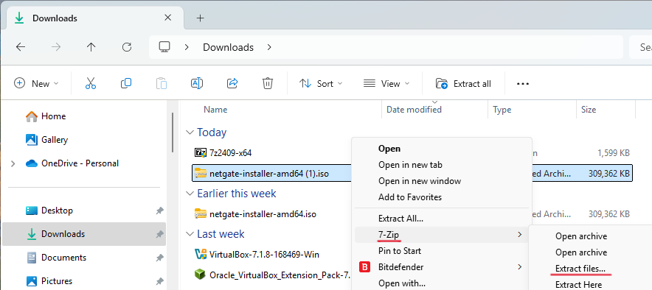
Installation

Slide 5
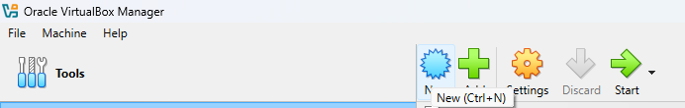
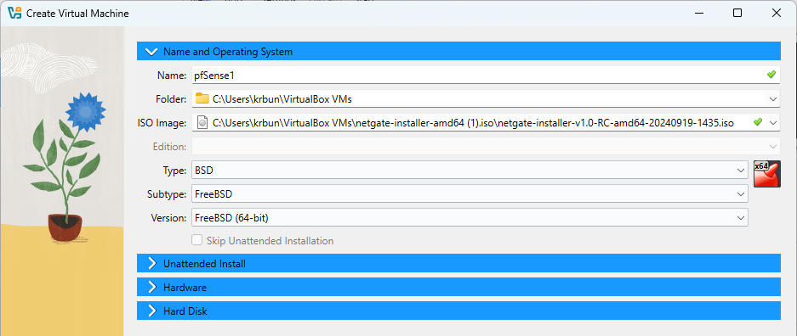
Installation

Slide 6
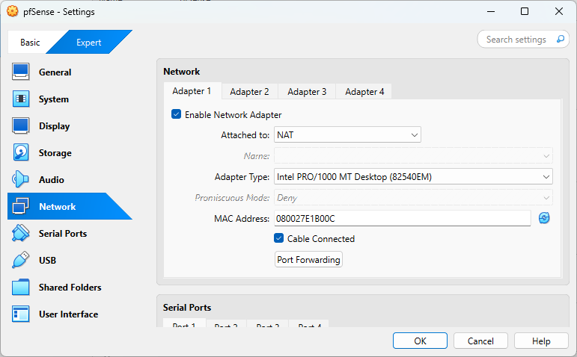
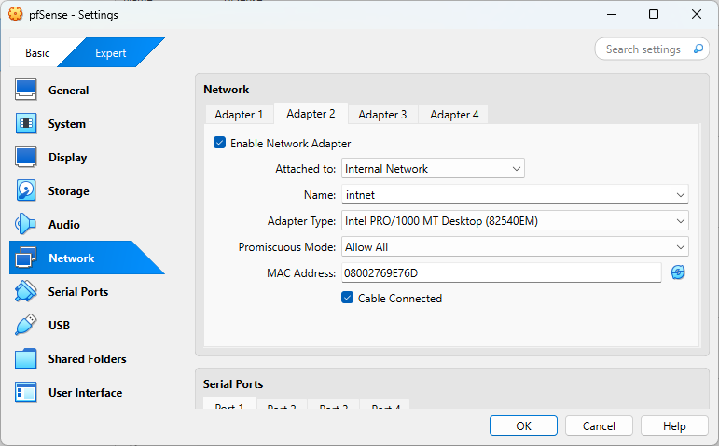
Installation

Slide 7
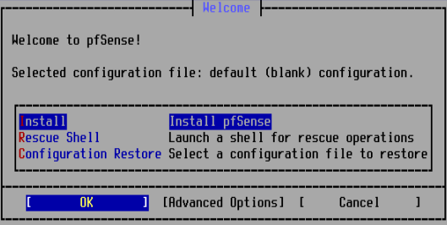
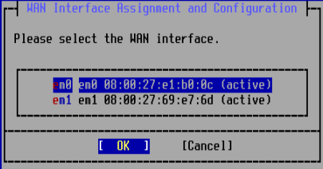
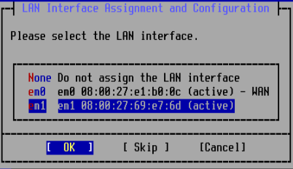
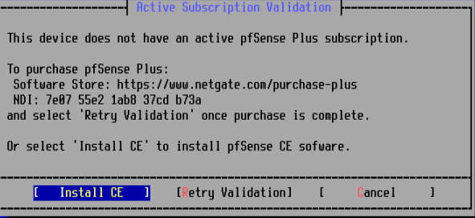
Installation

Slide 8
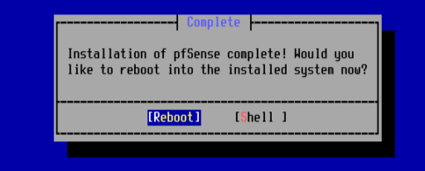
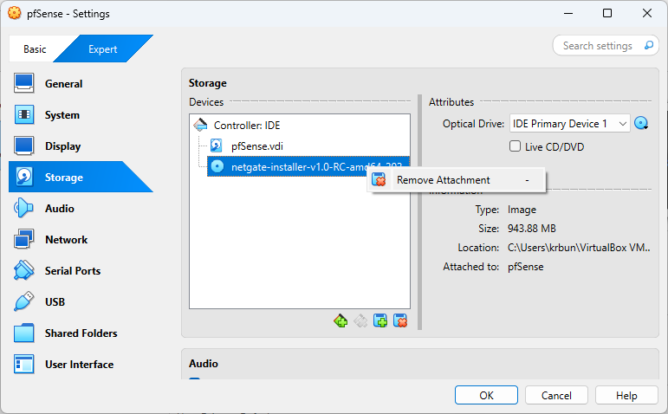
Installation

Slide 9
pfSense as a Firewall
Pellegrino Adu Gyamfi

Slide 10

What is a Firewall?
A device or software that controls incoming and outgoing traffic based on rules
Prevents unauthorized access
Packet Inspection
Monitors traffic

Slide 11
How is pfSense used as a Firewall?
You can use pfSense as a firewall by configuring it to control and monitor network traffic between your Local Area Network (LAN) and External Area Networks (WAN). pfSense uses stateful packet inspection, meaning it tracks active connections and allows only permitted traffic based on defined firewall rules.

Slide 12
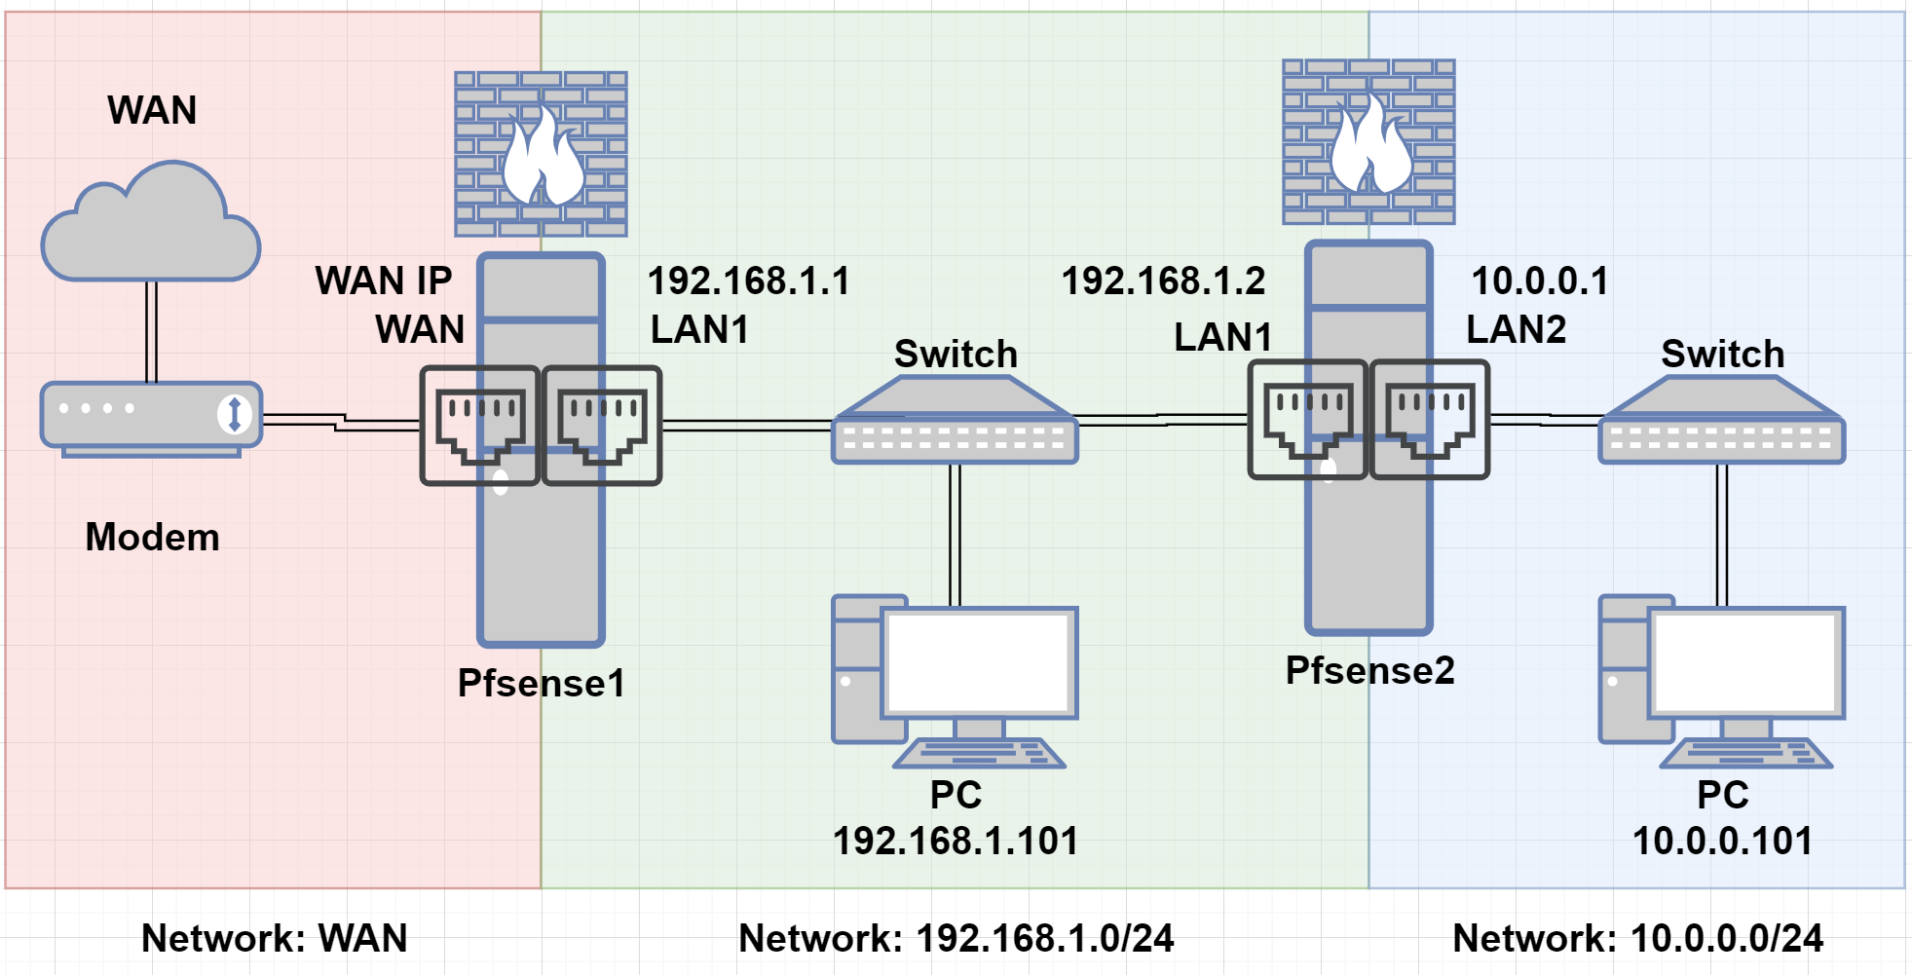
Topography of pfSense used in a Network

Slide 13
Advanced Firewall Features in pfSense
Port Forwarding & IP Rules: Easily manage access to internal services by forwarding ports and controlling traffic based on IP addresses.
Floating Rules: Apply firewall rules across multiple interfaces for consistent security policies across your entire network.
pfBlockerNG: an add-on package that allows you to block ads, malware, malicious domains, and even entire countries
Scheduled Rules: Create rules that automatically activate or deactivate based on time—like blocking internet access at night.
Notes:
pfSense allows you to install additional features via packages such as:

Slide 14
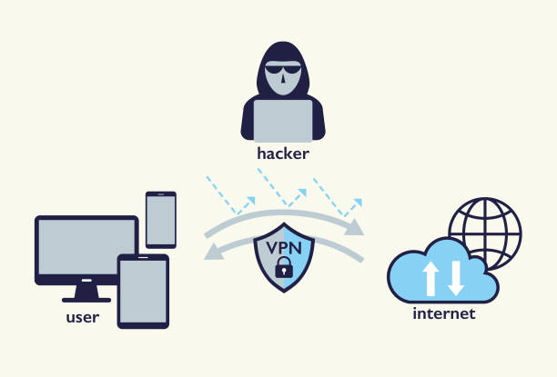
Creating a VPN with pfSense
By Ernest Graham

Slide 15
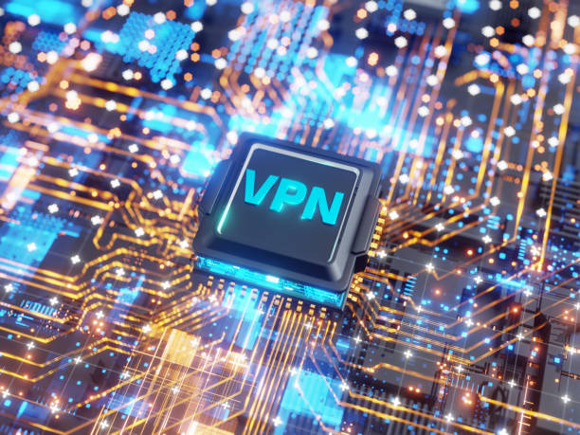
Whole network VPN
pfSense VPN refers to using the pfSense firewall/router operating system to manage or create a VPN (Virtual Private Network).
Instead of having to download and configure OpenVPN clients on each of your devices you can just configure it once on your pfSense router and you’ll never have to worry about browsing unprotected again.

Slide 16
Types of VPN in PfSense
OpenVPN (Most Common) - Secure and flexible
Works well with mobile, desktop and site-to site-connections.
Can use user authentication via Radius, LDAP, or pfSense local users
Compatible with the OpenVPN client for Windows, macOS, Linux, iOS and Android.

Slide 17
Types of VPN in PfSense
WireGuard (pfsense 2.5+)
Modern and extremely fast/lightweight VPN protocol
Easier to configure than IPsec
Not natively supported on all older devices

Slide 18
Types of VPN in PfSense
IPsec
Standard protocol, commonly used for site-to-site or with third party firewalls (Cisco,Fortinet)
Slightly more complex to configure than OpenVPN
Can also be used with L2TO for road warriors

Slide 19
Types of VPN in PfSense
L2TP/Ipsec
Deprecated in many cases, but still available
Can work with built-in clients on Windows/MacOS
Less secure than OpenVPN or WireGuard

Slide 20

Routing Fundamentals & Implementation with pfSense+
Abdirahman Aynab

Slide 21
pfSense Routing Interfaces
WAN: In pfSense, the WAN (Wide Area Network) interface represents the external network connection — typically your internet connection from an ISP. It’s where your firewall connects to the outside world.
LAN: In pfSense, the LAN (Local Area Network) interface represents your internal/private network — where your trusted devices like computers, printers, and servers are connected. It’s the default interface that pfSense uses to provide routing, DHCP, DNS, firewall protection, and internet access to your local devices.

Slide 22
pfSense Implementation
Static Routing:
Configured under System → Routing → Static Routes.
(Must Specify)
Destination network
Subnet mask
Gateway
Apply Settings to update and save.
Notes:
KEY CONCEPTS:
Manual Configuration: The network administrator defines each route.
Fixed Paths: Once set, the path to a destination doesn’t change unless manually updated.
Next-Hop or Gateway: You must specify where the traffic should go next (usually an IP address or interface).

Slide 23
PfSense Implementation
Dynamic Routing
(via packages):
OSPF(Open Shortest Path First)
BGP(Border Gateway Protocol)
RIP(Routing Information Protocol)
FRR(Free Range Routing) package. Offers dynamic path adjustments based on network changes
Notes:
Key Features of Dynamic Routing:
Automatic route updates based on changes in the network.
Scalability for large, complex networks.
Redundancy and failover, allowing for alternate paths if a link fails.
Load balancing (in some protocols).
RIP- Is used to dynamically share routing information within small or medium-sized internal networks.
OSPF- Is a link-state routing protocol used for routing data within a single organization or autonomous system.
BGP- Is the primary routing protocol used to exchange routing information between autonomous systems on the Internet.
FRR- Is an open-source IP routing protocol suite designed for Unix/Linux systems. It provides high-performance, scalable implementations of both interior and exterior gateway protocols — and it can be integrated with pfSense to enhance its routing capabilities beyond the basic GUI features.

Slide 24
pfSense Demonstration
Ben Widrig

Slide 25
Demo Preview
In the Demo, we will show how to:
Access the pfSense interface
Use pfSense as a router
Use pfSense as a firewall
Set up a VPN with pfSense

Slide 26
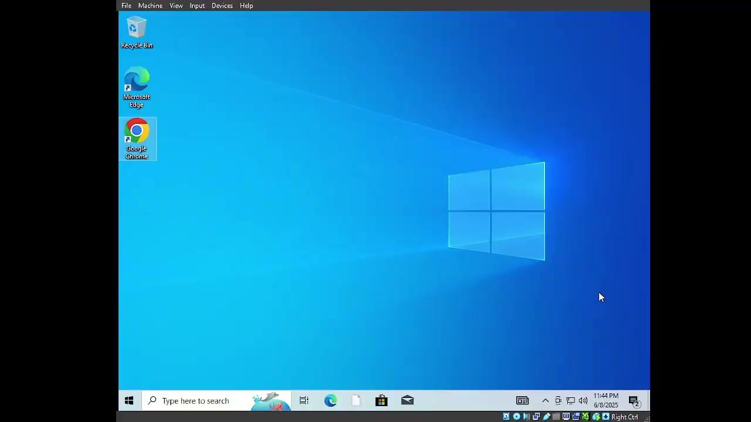
Demo

